Slide 1
Classification
September 24, 2019
Anna Yeaton

Slide 2
Regression vs Classification
Regression
Classification
Quantitative values
Height
Age
Monetary value
Qualitative values
Gender
Mood
Color
Height (cm) | Age | Monetary value ($)
167 | 59 | 5.40
159 | 30 | 7.90
145 | 14 | 21.99
160 | 25 | 30.75
Gender | Mood | Color
F | Happy | Red
M | Sad | Purple
M | Angry | Green
F | Happy | Blue

Slide 3
Classification is a multi-step process
Choosing/constructing the model
2. Splitting the the data into independent training and test sets
3. Apply the model on the training set
Estimate the accuracy/performance of the model
Choose a model that works well on the training set
4. Apply the model to the test set
Estimate the performance of the model
If the model performs well on the independent test set, we can use this model to classify new data

Slide 4
Split the data into independent training and test sets
We want our model to be robust to new data. There is little point in a model that describes the data at hand with no opportunity to apply the model to a new dataset
Test set
Training set
~70% of the total data. The exact split depends on the data at hand
Total dataset
* You may come across validation sets. Validation sets are often used in Deep Learning to help select models

Slide 5
Applying the model on the training set
X1 | X2 | … | Xn
Y
Training set

Slide 6
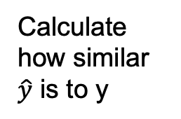
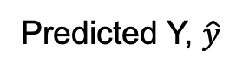
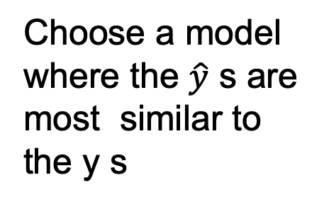
Apply the model on the training set
X1 | X2 | … | Xn
Y
Predicted Y, $\hat{y}$
Calculate how similar $\hat{y}$ is to y
Model
Training set
Choose a model where the $\hat{y}$ s are most similar to the y s

Slide 7
Apply model on test set
X1 | X2 | … | Xn
Y
Predicted Y, $\hat{y}$
Calculate how similar $\hat{y}$ is to y
Report how well the model performed on the test set

Slide 8
Model Evaluation and Selection: Confusion matrix
Confusion matrix in terms of Red
 | Actual Red | Actual Blue
Predicted Red | True Positive (TP) | False Positive (FP) Type I error | Total Red Predictions(P’)
Predicted Blue | False Negative (FN) Type II error | True Negative (TN) | Total Blue Predictions (N’)
 | Total Actual Red (P) | Total Actual Blue (N) | All
We want to maximize
We want to minimize

Slide 9
Model Evaluation and Selection: Confusion matrix
Predicted | Actual
Red | Red
Red | Red
Red | Red
Red | Red
Red | Blue
Red | Blue
Blue | Red
Blue | Blue
Blue | Blue
Blue | Blue
Blue | Blue
Blue | Blue
Blue | Blue
 | Actual Red | Actual Blue
Predicted Red | True Positive (TP) | False Positive (FP) | Pred R
Predicted Blue | False Negative (FN) | True Negative (TN) | Pred B
 | Actual R | Actual B | All
Linear decision boundary
Blue
Red

Slide 10
Model Evaluation and Selection: Confusion matrix
Predicted | Actual
Red | Red
Red | Red
Red | Red
Red | Red
Red | Blue
Red | Blue
Blue | Red
Blue | Blue
Blue | Blue
Blue | Blue
Blue | Blue
Blue | Blue
Blue | Blue
 | Actual Red | Actual Blue
Predicted Red | True Positive (TP) = 4 | False Positive (FP) = 1 | Pred R 5
Predicted Blue | False Negative (FN) = 2 | True Negative (TN) = 6 | Pred B 8
 | Actual R 6 | Actual B 7 | All 13
Linear decision boundary
Blue
Red

Slide 11
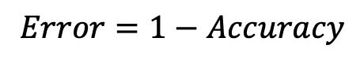
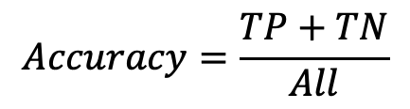
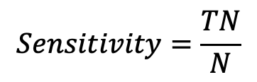
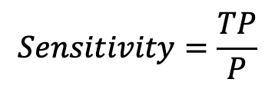
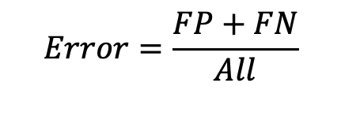
Model Evaluation and Selection: Accuracy, Error rate, Sensitivity and Specificity
Accuracy
Sensitivity
$$Accuracy=\frac{TP+TN}{All}$$
$$Sensitivity=\frac{TP}{P}$$
Percentage correctly identified
True positive recognition rate
Error
Specificity
$$Error=1−Accuracy$$
$$Sensitivity=\frac{TN}{N}$$
or
$$Error=\frac{FP+FN}{All}$$
True negative recognition rate
Percentage incorrectly identified

Slide 12
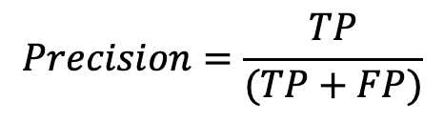
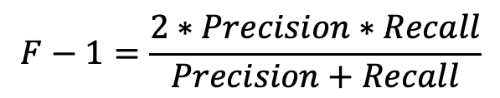
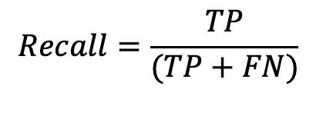
Model Evaluation and Selection: Precision, Recall and F-1 measures
Precision
F-1
$$Precision=\frac{TP}{(TP+FP)}$$
$$F−1=\frac{2∗Precision∗Recall}{Precision+Recall}$$
Percentage of data predicted as positive is actually positive
Harmonic mean of precision and recall
Perfect precision and recall result in an F-1 score of 1
At the absolute worst precision and recall F-1 score will be 0
Recall
$$Recall=\frac{TP}{(TP+FN)}$$
Percentage of positive data was predicted as positive

Slide 13
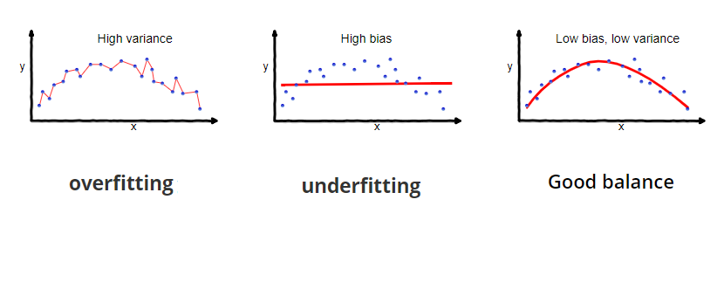
Bias vs Variance Trade-off
Seema Singh
https://towardsdatascience.com/understanding-the-bias-variance-tradeoff-165e6942b229

Slide 14
There is no free lunch
No one method dominates over other methods on all datasets
Decide for a given dataset what method works best by measuring quality of fit for each model

Slide 15
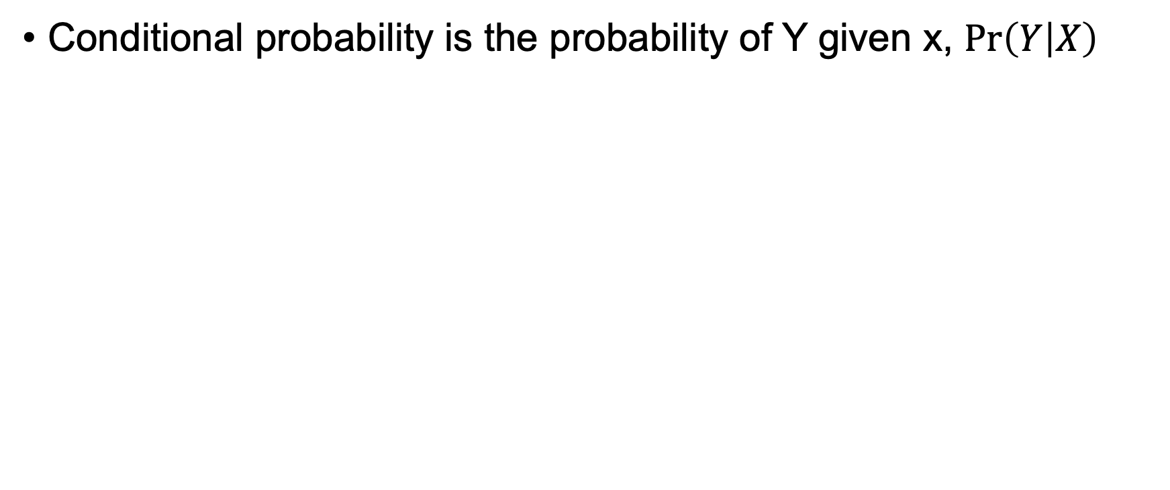
Ultimately, we are interested in the conditional probability
Conditional probability is the probability of Y given x, $\operatorname{Pr}\left(Y | X\right)$
X1 | X2 | … | Xn
Y

Slide 16
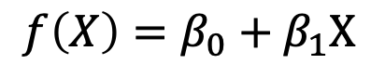
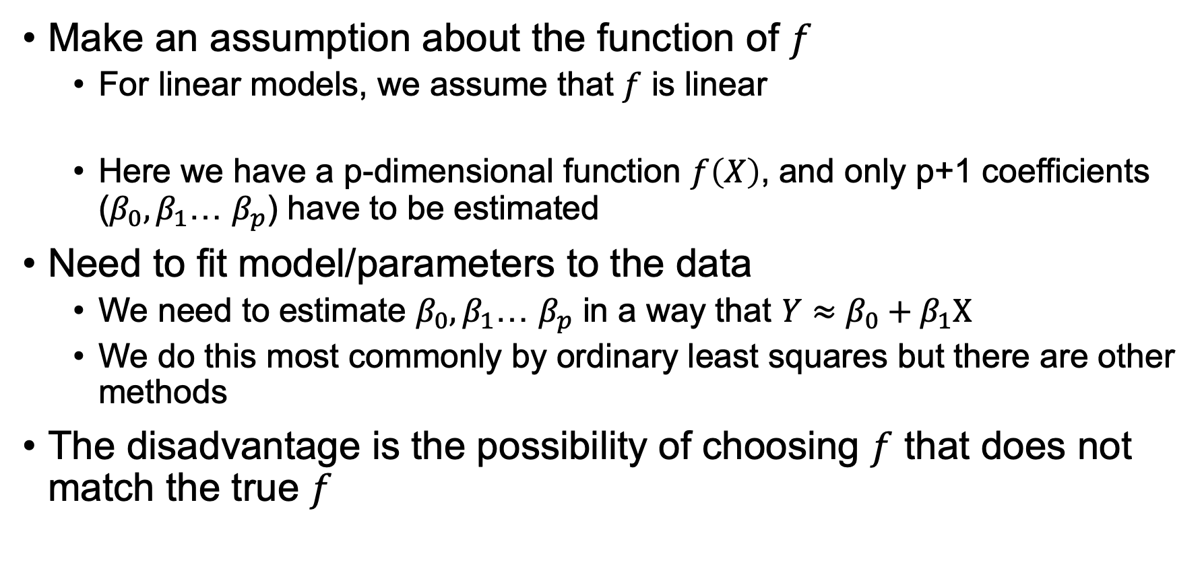
Parametric models
Make an assumption about the function of $f$
For linear models, we assume that $f$ is linear
Here we have a p-dimensional function $f\left(X\right)$, and only p+1 coefficients ($β_{0}, β_{1}$… $β_{p}$) have to be estimated
Need to fit model/parameters to the data
We need to estimate $β_{0}, β_{1}$… $β_{p}$ in a way that $Y≈β_{0}+β_{1}X$
We do this most commonly by ordinary least squares but there are other methods
The disadvantage is the possibility of choosing $f$ that does not match the true $f$
$$f\left(X\right)=β_{0}+β_{1}X$$

Slide 17
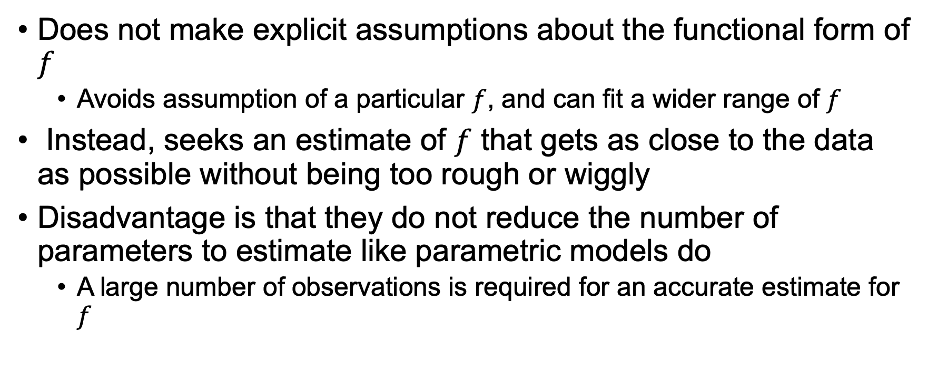
Non-parametric models
Does not make explicit assumptions about the functional form of $f$
Avoids assumption of a particular $f$, and can fit a wider range of $f$
Instead, seeks an estimate of $f$ that gets as close to the data as possible without being too rough or wiggly
Disadvantage is that they do not reduce the number of parameters to estimate like parametric models do
A large number of observations is required for an accurate estimate for $f$

Slide 18
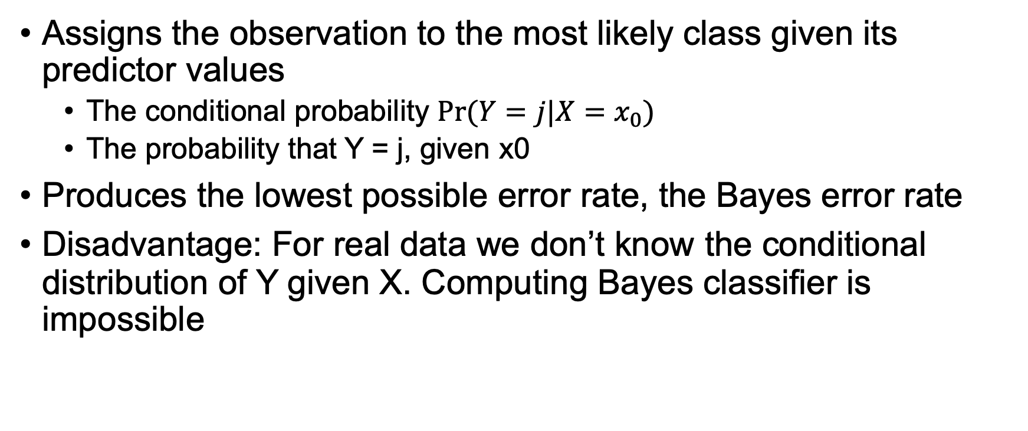
Bayes’ Classifier, an unattainable gold standard for real data
Assigns the observation to the most likely class given its predictor values
The conditional probability $Pr⁡(Y=j|X=x_{0})$
The probability that Y = j, given x0
Produces the lowest possible error rate, the Bayes error rate
Disadvantage: For real data we don’t know the conditional distribution of Y given X. Computing Bayes classifier is impossible

Slide 19
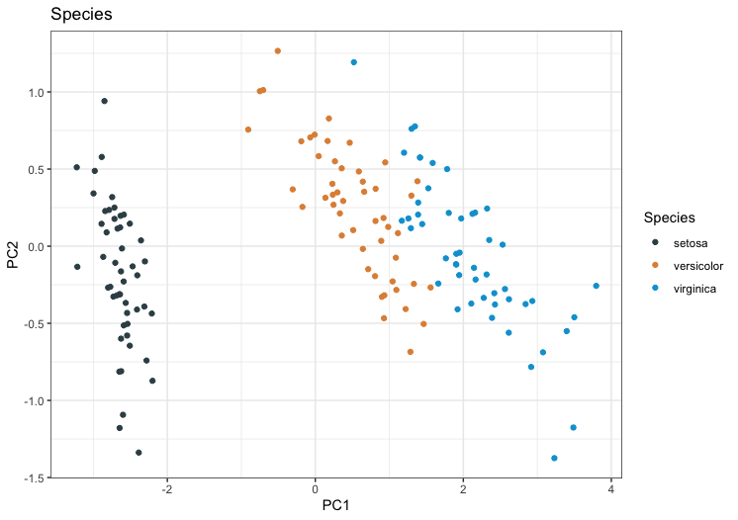
Why not linear regression?
1 if setosa
Y =
2 if versicolor
3 if virginica
Notes:
Unfortunately, this coding implies an ordering on the outcomes, putting versicolor
in between setosa
and verginica, and insisting that the diﬀerence between
Setosa and versicolor is the same as the diﬀerence between
Versicolor and virginica

Slide 20
Why not linear regression?
1 if setosa
Y =
2 if versicolor
3 if virginica
Orders outcomes
Difference between setosa and versicolor must be the same as the difference between versicolor and virginica
Notes:
Unfortunately, this coding implies an ordering on the outcomes, putting versicolor
in between setosa
and verginica, and insisting that the diﬀerence between
Setosa and versicolor is the same as the diﬀerence between
Versicolor and virginica

Slide 21
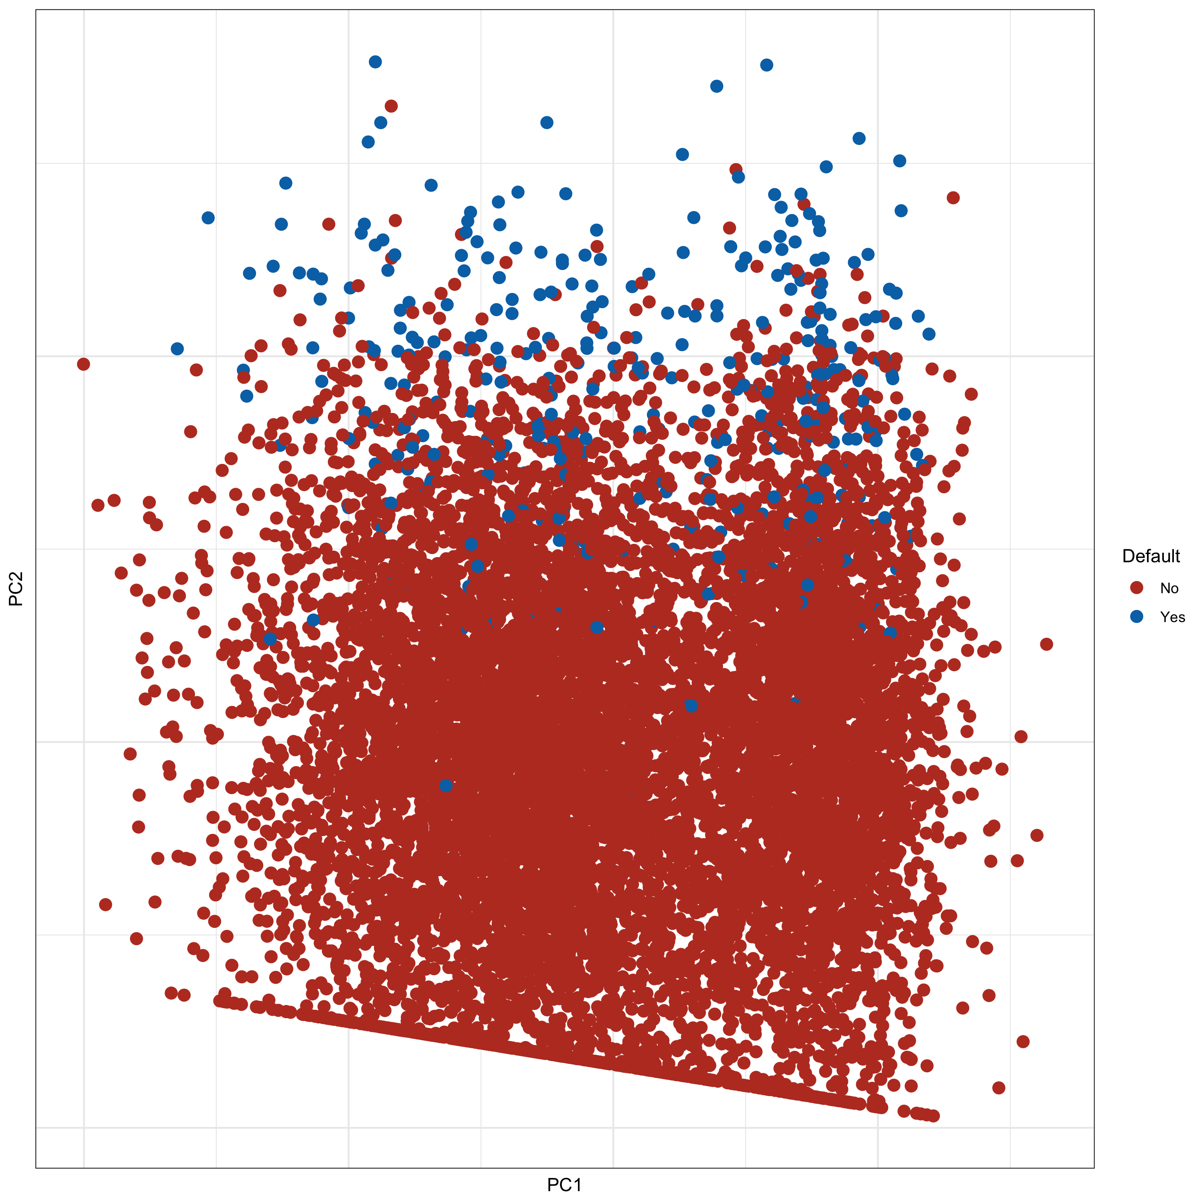
We could try linear regression for a binary task
Default | Student | Balance of debt | Income
No | No | 729.52650 | 44361.625
No | Yes | 817.18041 | 12106.135
… | … | … | …
1 if default = yes
Y =
0 if default = no
Notes:
No 729.52650 44361.625
No Yes 817.18041 12106.135

Slide 22
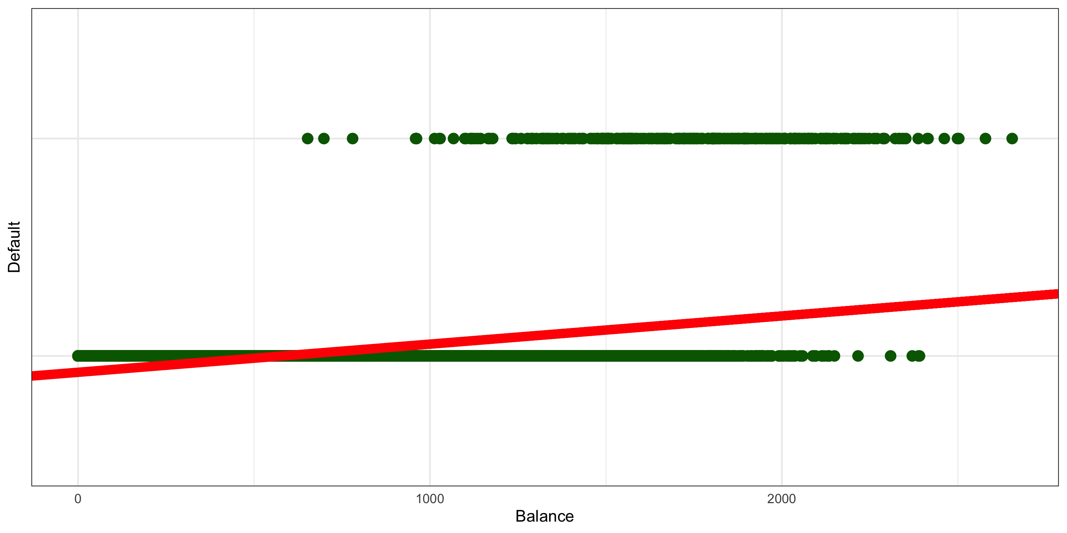
We can model the probability of Y given X, Pr(Y|X), using a linear model
lm(default ~ balance, data = Default)
1
0
Balance
Hard to interpret as probabilities
Notes:
Why cant it be horz ?

Slide 23
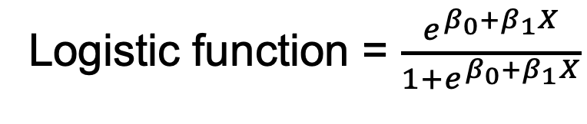
Logistic Regression
Models the probability that Y belongs to a category given X
Pr(Y|X) which we abbreviate to p(X)
Outputs values between 0 and 1 by using the logistic function
Logistic function = $\frac{e^{β_{0}+β_{1}X}}{1+e^{β_{0}+β_{1}X}}$
Notes:
Define terms
B and X

Slide 24
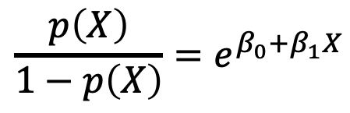
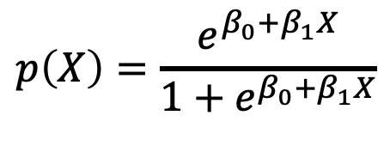
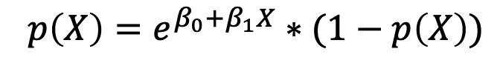
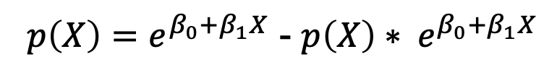
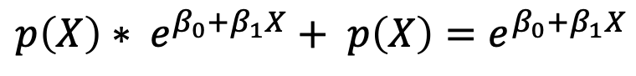
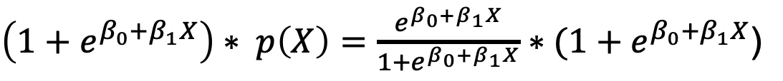
Logistic Regression cont.
$$p\left(X\right)=\frac{e^{β_{0}+β_{1}X}}{1+e^{β_{0}+β_{1}X}}$$
Pr(Y|X)
Logistic function
$\left(1+e^{β_{0}+β_{1}X}\right)∗ p\left(X\right)=\frac{e^{β_{0}+β_{1}X}}{1+e^{β_{0}+β_{1}X}}∗(1+e^{β_{0}+β_{1}X}$)
$${p\left(X\right)∗ e}^{β_{0}+β_{1}X}+ p\left(X\right)=e^{β_{0}+β_{1}X}$$
$p\left(X\right)=e^{β_{0}+β_{1}X}$ - ${p\left(X\right)∗ e}^{β_{0}+β_{1}X}$
$$p\left(X\right)=e^{β_{0}+β_{1}X}∗(1−p\left(X\right))$$
$$\frac{p\left(X\right)}{1−p\left(X\right)}=e^{β_{0}+β_{1}X}$$
Odds
Notes:
B is your params and X is your input data

Slide 25
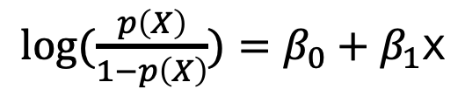
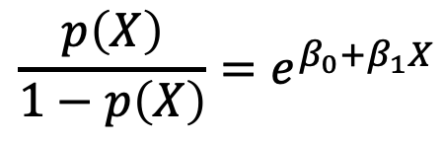
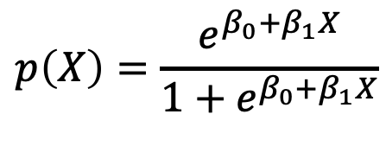
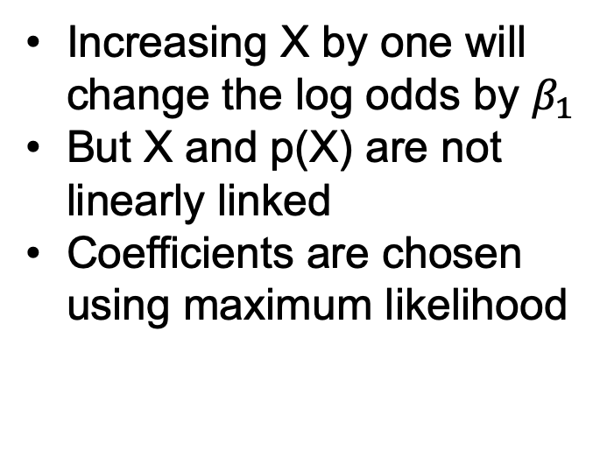
Logistic Regression cont.
$$p\left(X\right)=\frac{e^{β_{0}+β_{1}X}}{1+e^{β_{0}+β_{1}X}}$$
Pr(Y|X)
Logistic function
$$\frac{p\left(X\right)}{1−p\left(X\right)}=e^{β_{0}+β_{1}X}$$
Increasing X by one will change the log odds by $β_{1}$
But X and p(X) are not linearly linked
Coefficients are chosen using maximum likelihood
Odds
Log Odds
Or logit
$log⁡(\frac{p\left(X\right)}{1−p\left(X\right)})=β_{0}+β_{1}$X

Slide 26
Output of logistic regression
logistic_regression <- glm(default ~ balance, data = Default,
family = binomial)
summary(logistic_regression)
Coefficients:
Estimate Std. Error z value Pr(>|z|)
(Intercept) -1.065e+01 3.612e-01 -29.49 <2e-16 ***
balance 5.499e-03 2.204e-04 24.95 <2e-16 ***
Evidence against the null hypothesis that default does not depend on balance
Accuracy of coefficient estimates
Notes:
In other words, we conclude that there is indeed an association between
balance
and probability of
default
.
The estimated intercept in Table 4.1is typically not of interest; its main purpose is to adjust the average ﬁttedprobabilities to the proportion of ones in the data

Slide 27
Multiple Logistic Regression
logistic_regression <- glm(default ~ balance + student + income, data = Default,
family = binomial)
summary(logistic_regression)
Coefficients:
Estimate Std. Error z value Pr(>|z|)
(Intercept) -1.087e+01 4.923e-01 -22.080 < 2e-16 ***
balance 5.737e-03 2.319e-04 24.738 < 2e-16 ***
studentYes -6.468e-01 2.363e-01 -2.738 0.00619 **
income 3.033e-06 8.203e-06 0.370 0.71152
Negative coefficient indicates that for a fixed value of balance and income, a student is less likely to default than a non-student
Largest z statistic indicates that balance is the most important determinant of default
Notes:
with a given credit card balance will tend to have alower probability of default than a non-student with the same credit cardbalance, the fact t

Slide 28
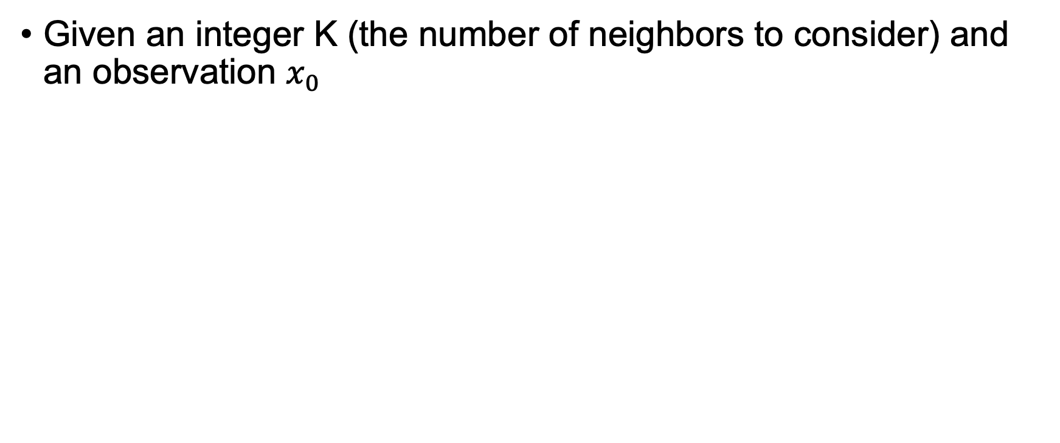
K-Nearest Neighbors (KNN)
Given an integer K (the number of neighbors to consider) and an observation $x_{0}$
New data x
K = 2
Class
Red
Blue

Slide 29
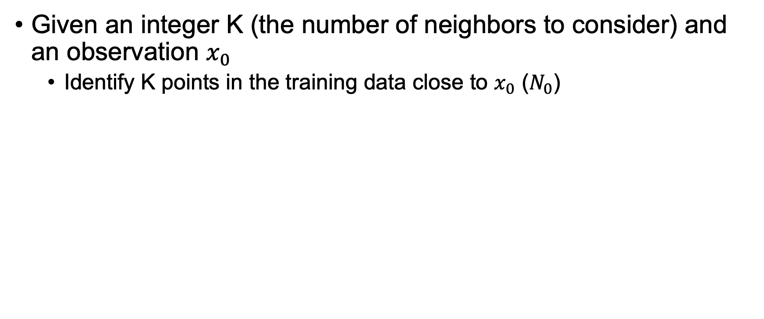
K-Nearest Neighbors (KNN)
Given an integer K (the number of neighbors to consider) and an observation $x_{0}$
Identify K points in the training data close to $x_{0}$ ($N_{0}$)
New data x
K = 2
Class
Red
Blue
Notes:
Grey

Slide 30
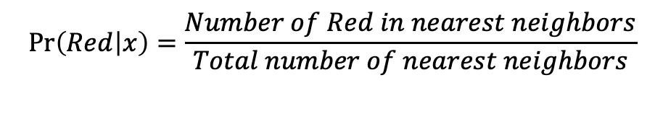
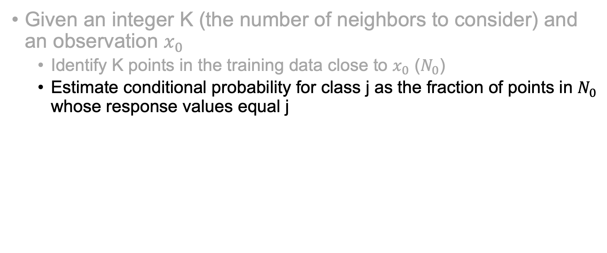


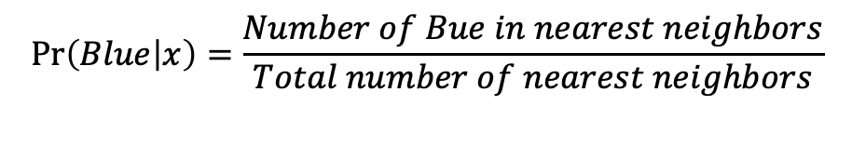
K-Nearest Neighbors (KNN)
Given an integer K (the number of neighbors to consider) and an observation $x_{0}$
Identify K points in the training data close to $x_{0}$ ($N_{0}$)
Estimate conditional probability for class j as the fraction of points in $N_{0}$ whose response values equal j
New data x
$$\operatorname{Pr}\left(Red | x\right)=\frac{Number of Red in nearest neighbors}{Total number of nearest neighbors}$$
K = 2
$$\operatorname{Pr}\left(Red | x\right)=1$$
Class
$$\operatorname{Pr}\left(Blue | x\right)=\frac{Number of Bue in nearest neighbors}{Total number of nearest neighbors}$$
Red
$$\operatorname{Pr}\left(Blue | x\right)=0$$
Blue

Slide 31
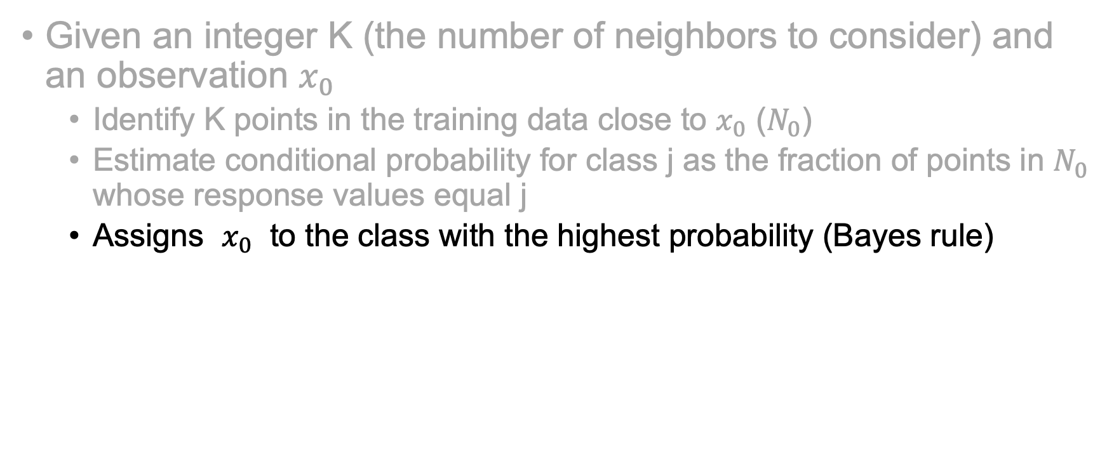


K-Nearest Neighbors (KNN)
Given an integer K (the number of neighbors to consider) and an observation $x_{0}$
Identify K points in the training data close to $x_{0}$ ($N_{0}$)
Estimate conditional probability for class j as the fraction of points in $N_{0}$ whose response values equal j
Assigns $x_{0}$ to the class with the highest probability (Bayes rule)
K = 2
$$\operatorname{Pr}\left(Red | x\right)=1$$
Class
$$\operatorname{Pr}\left(Blue | x\right)=0$$
Red
Blue

Slide 32
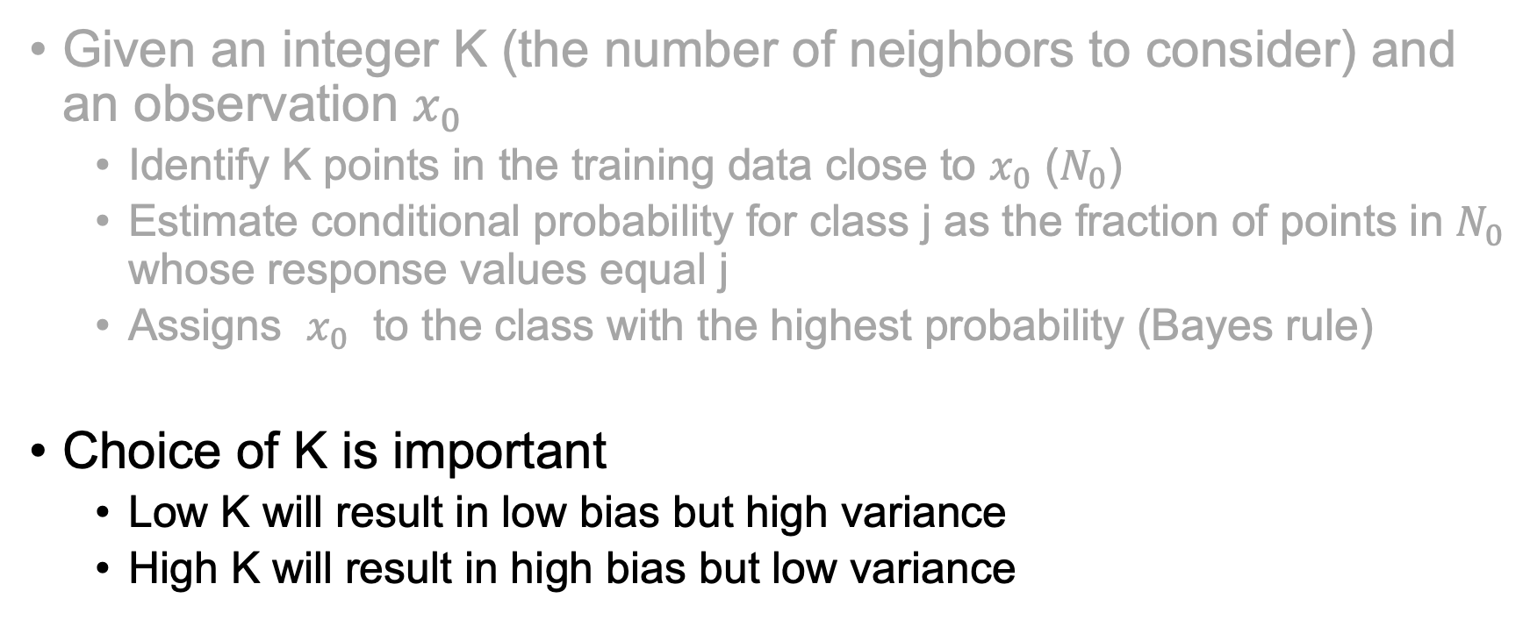
K-Nearest Neighbors (KNN)
Given an integer K (the number of neighbors to consider) and an observation $x_{0}$
Identify K points in the training data close to $x_{0}$ ($N_{0}$)
Estimate conditional probability for class j as the fraction of points in $N_{0}$ whose response values equal j
Assigns $x_{0}$ to the class with the highest probability (Bayes rule)
Choice of K is important
Low K will result in low bias but high variance
High K will result in high bias but low variance

Slide 33
Which is parametric, KNN or Logistic Regression?
What are some downsides to each method?

Slide 34
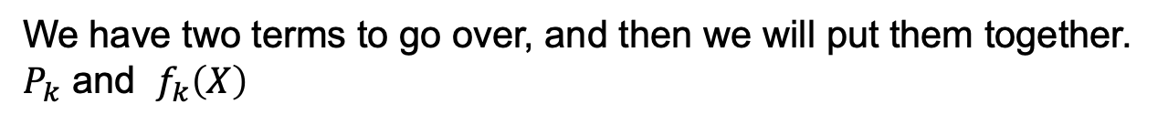
Linear Discriminant Analysis
Linear discriminant analysis is popular when we have more than two response classes
When the classes are well-separated, the parameter estimates for the logistic regression model are surprisingly unstable
If n is small and the distribution of the predictors X is approximately normal in each of the classes, LDA performs well
We have two terms to go over, and then we will put them together.
$P_{k}$ and $f_{k}\left(X\right)$

Slide 35
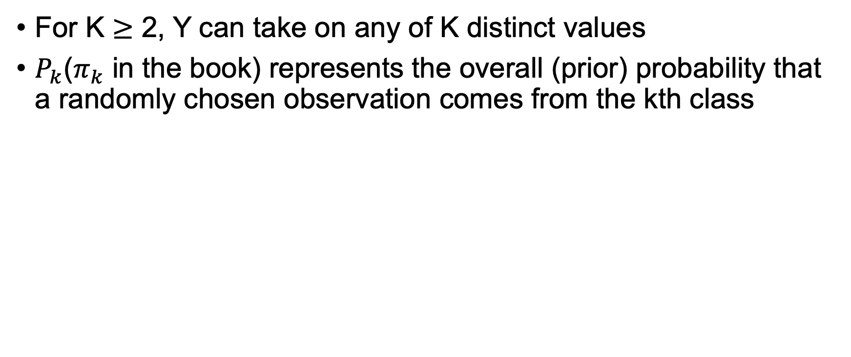

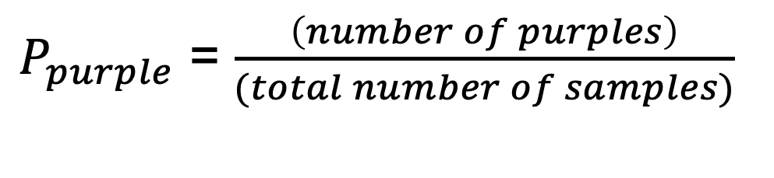
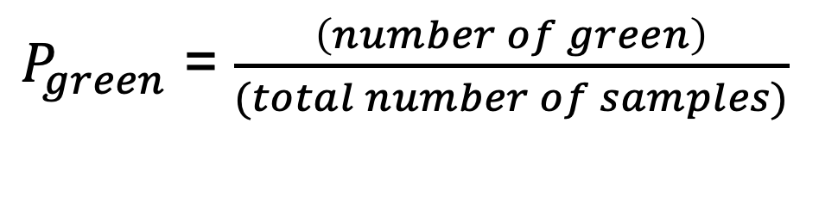
Linear Discriminant Analysis, $P_{k}$
For K $≥$ 2, Y can take on any of K distinct values
$P_{k}$($π_{k}$ in the book) represents the overall (prior) probability that a randomly chosen observation comes from the kth class
K is either green or purple
$P_{green}$ = $\frac{\left(number of green\right)}{(total number of samples)}$
$P_{purple}$ = $\frac{\left(number of purples\right)}{(total number of samples)}$
Notes:
π_i = n_i / sum(n)
Change pi to something more palatable == P

Slide 36
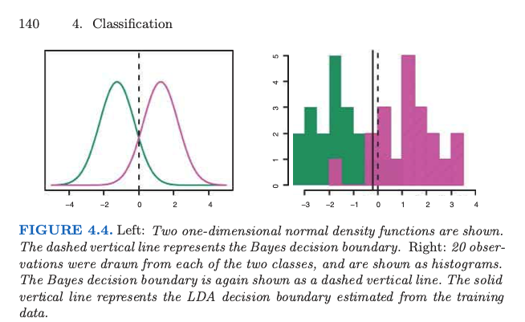
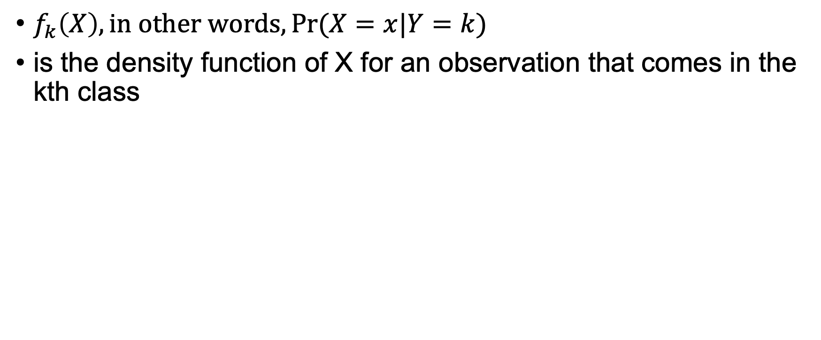

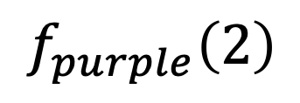
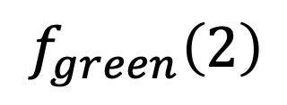
Linear Discriminant Analysis, $f_{k}\left(X\right)$
$f_{k}\left(X\right), in other words, Pr⁡(X=x|Y=k)$
is the density function of X for an observation that comes in the kth class
$$f_{purple}\left(2\right)$$
$$f_{green}\left(2\right)$$
Density function of X values
Histogram of X values
Notes:
X == given you r input variable
K is the classes
X is the new data X the his is the prev seen data – resids
Discuss the prob dist and how important it is to have separate means

Slide 37
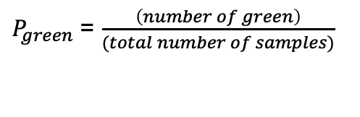

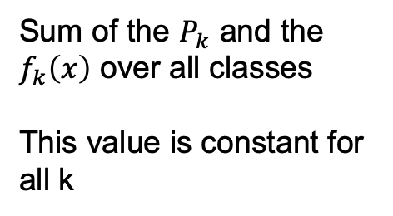
Linear Discriminant Analysis all together
Prior probability
density function of X for an observation for that kth class
$P_{green}$ = $\frac{\left(number of green\right)}{(total number of samples)}$
Probability that Y equals K, given x
$$\operatorname{Pr}\left(Y=k | X=x\right)=\frac{P_{k}f_{k}\left(x\right)}{\sum_{l=1}^{K}{P_{l}}f_{l}(x)}$$
The k with the greatest probability given x, is the predicted class
Sum of the $P_{k}$ and the $f_{k}\left(x\right)$ over all classes
This value is constant for all k

Slide 38
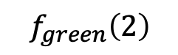
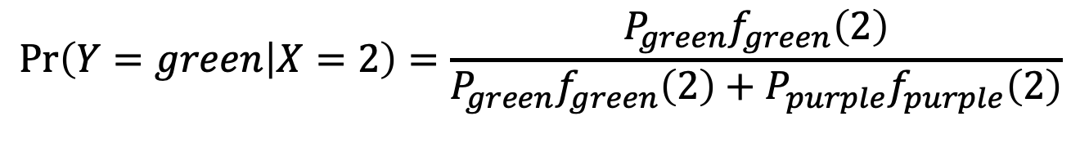




Linear Discriminant Analysis example
Let’s say that x = 2
Y is either green or purple
$$f_{purple}\left(2\right)≫$$
$$f_{green}\left(2\right)$$
-3
-2
-1
0
1
2
3
X
$$\operatorname{Pr}\left(Y=green | X=2\right)=\frac{P_{green}f_{green}\left(2\right)}{P_{green}f_{green}\left(2\right)+P_{purple}f_{purple}\left(2\right)}$$
$$P_{green}=\frac{number greens}{total}= \frac{10}{19}$$
$$P_{purple}=\frac{number purple}{total}= \frac{9}{19}$$
$$\operatorname{Pr}\left(Y=purple | X=2\right)=\frac{P_{purple}f_{purple}\left(2\right)}{P_{green}f_{green}\left(2\right)+P_{purple}f_{purple}\left(2\right)}$$

Slide 39
LDA assumes many things
Observations within each class come from a normal distribution with a class-speciﬁc mean and a common variance
This is often not true
Now, we have Quadratic discriminant analysis (QDA) which is more flexible and allows for class specific variance
Normal distribution
Class specific mean
Common variance

Slide 40
Last things to consider
Trade off between prediction accuracy and model interpretability
Class imbalances

